Slide 1
Hotel Management System

Slide 2
Starter
Explain the connection between Models, Views and Controllers

Slide 3
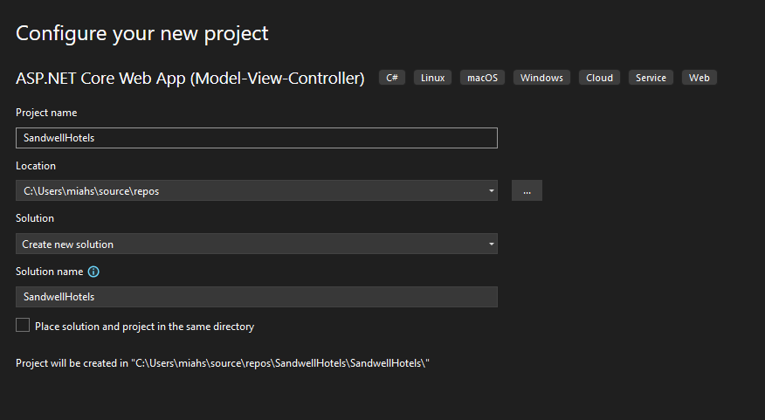
Create a new Project called Sandwell Hotels

Slide 4
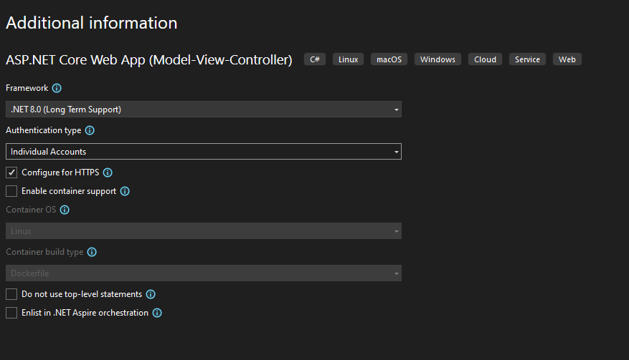
Make sure to select .NET 8.0 and Individual Accounts

Slide 5
Install the 3 Packages from the NPM
Install
Install-Package Microsoft.VisualStudio.Web.CodeGeneration.Design
Install
Install-Package Microsoft.EntityFrameworkCore.Design
Install
Install-Package Microsoft.EntityFrameworkCore.SqlServer

Slide 6
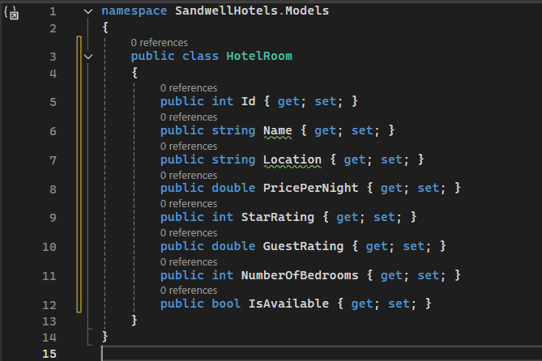
Create a new model for a Hotel Room

Slide 7
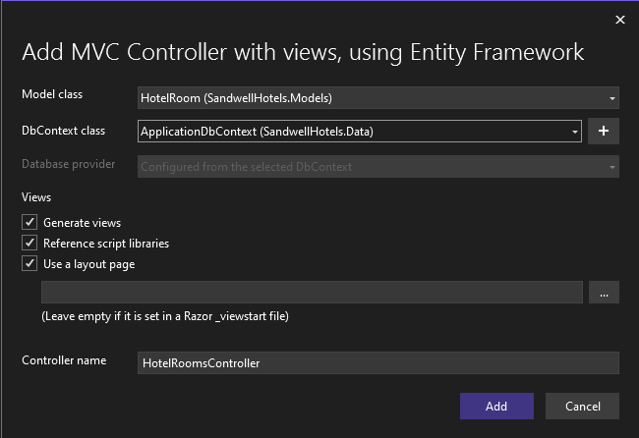
Scaffold a Controller and views based off this model

Slide 8
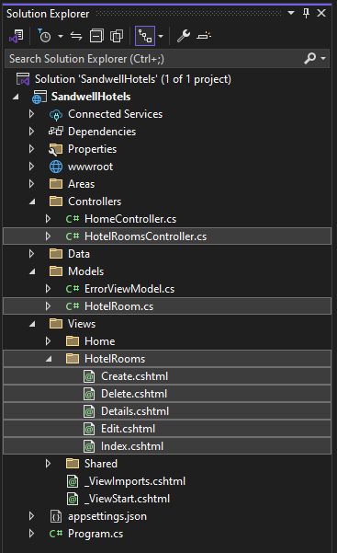
Should now have the following structure

Slide 9
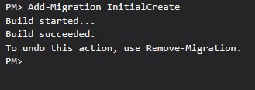
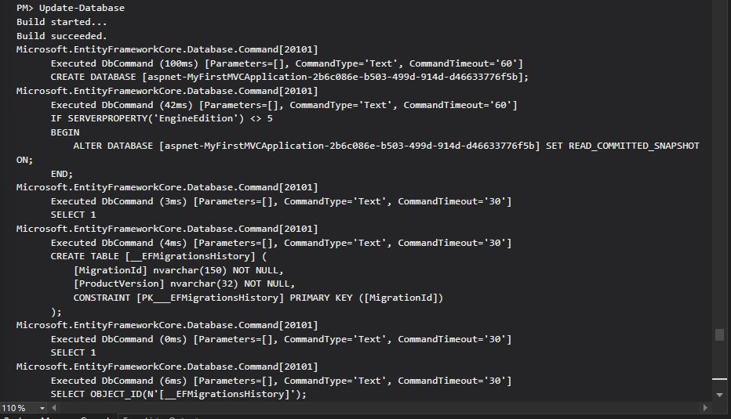
Add-Migration and Update-Database

Slide 10
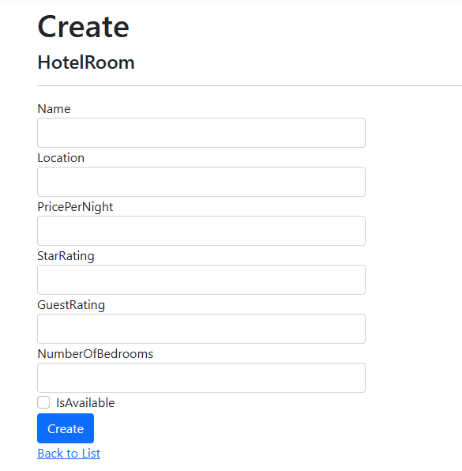
Now let's add some hotel rooms to our database

Slide 11
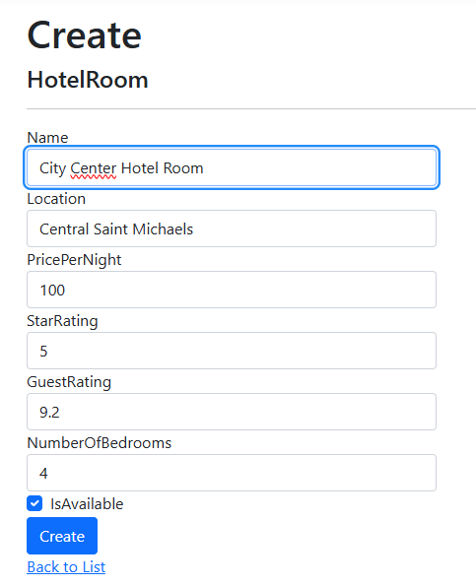
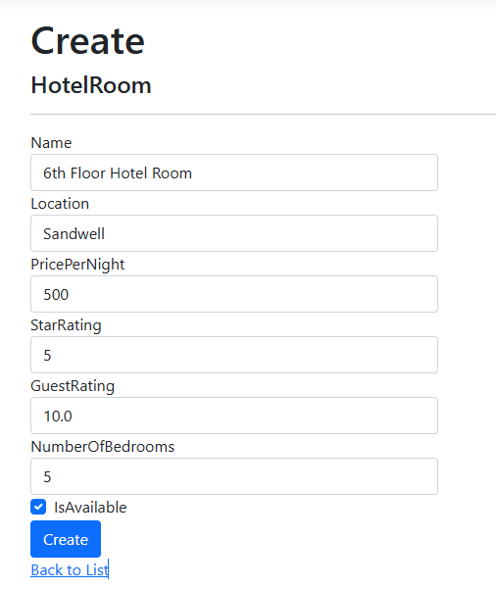
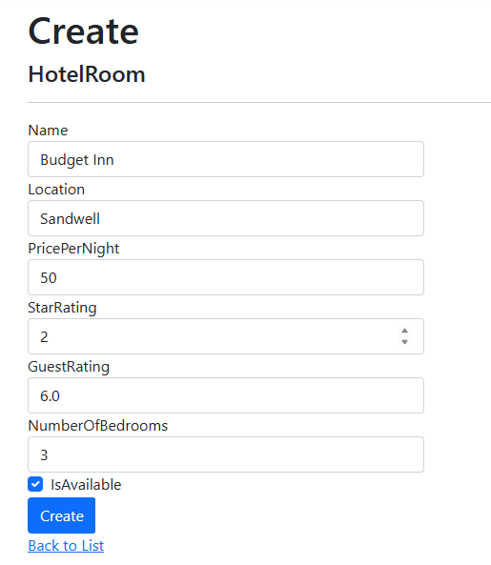
Create the following 3 Hotel Rooms

Slide 12
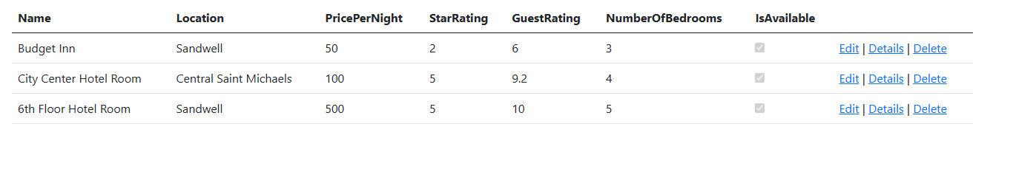
Should now have the following data

Slide 13
Methods we are going to add to the controller
Filter By Bedrooms
Only Display Available Rooms
Search for a room by Location or by the Name
Sorting the rooms by Price or by Star Rating or by Guest Rating

Slide 14
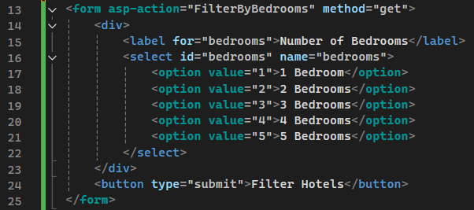
Filter By Bedrooms Form
First, we create the form in the Index View in the HotelRooms Folder

Slide 15
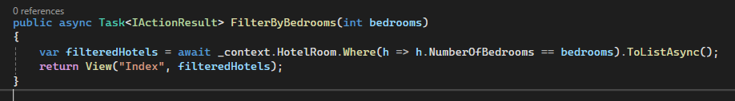
FilterByBedrooms Endpoint in the Controller
We create a variable finding all hotels with that many bedrooms
Then we return the Index view passing the variable through

Slide 16
Test it Out

Slide 17
What is the problem?

Slide 18
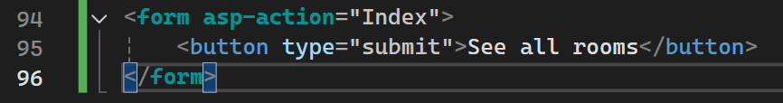
Form to See all Rooms
Now we have a way to return back to our original view with all hotel rooms on display

Slide 19
Only Display Available Rooms

Slide 20
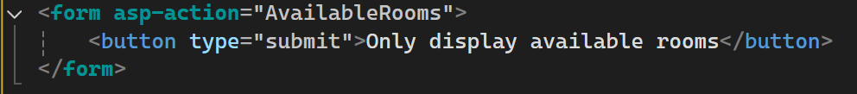
Form to Access the Method
This form can now be run to allow us to run the method to only display available rooms.
Could be done with an "<a>" tag as well

Slide 21
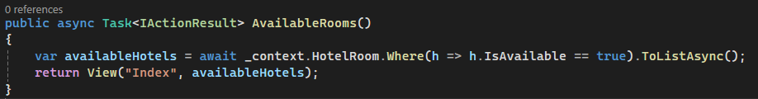
AvailableRooms Endpoint Method
Similar to the Bedrooms Endpoint.
Create a new variable and searches for all hotel rooms where IsAvailable is True.
Returns the Index View with the variable passed through

Slide 22
Test it Out

Slide 23
Task
Find all rooms in a specific location

Slide 24
Sorting the rooms by a factor of your choice

Slide 25
Add two buttons to allow to sort
Two <a> tags willl allow users to hit the corresponding endpoint
Difference is the value of ascending that is passed through either false or true

Slide 26
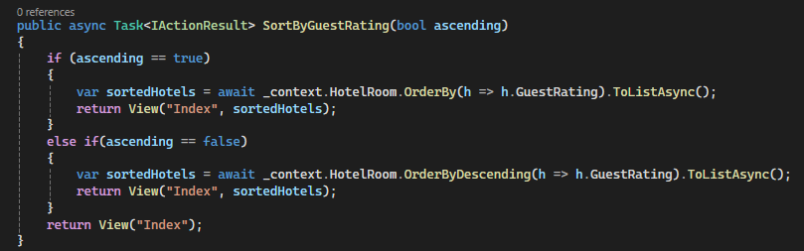
SortByGuestRating Endpoint Method
If statement to check if it is in ascending or descending order.
Create the variable where it uses "OrderBy" to sort the data
Returns the Index View with the variable passed through

Slide 27
Filter by a Minimum and Maximum Price

Slide 28
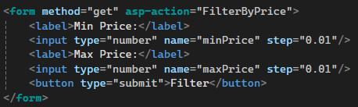
Filter By Price Form
Create a form to hit the right endpoint
Two number inputs for the minimum and maximum price
Submit Button

Slide 29
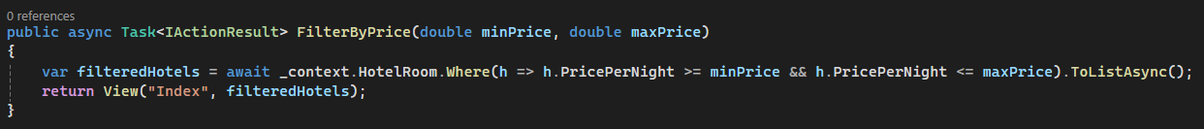
Filter By Price Endpoint Method
Create the variable searching for where the PricePerNight is greater than or equal to the minimum AND PricePerNight is less than or equal to the maximum
Returns the Index view with the variable passed through

Slide 30
Task
Add a filter for every column in your model

Slide 31
Next Lesson: Booking a Hotel Room

